Slide 1
The Prophets: Getting Ready

Slide 2
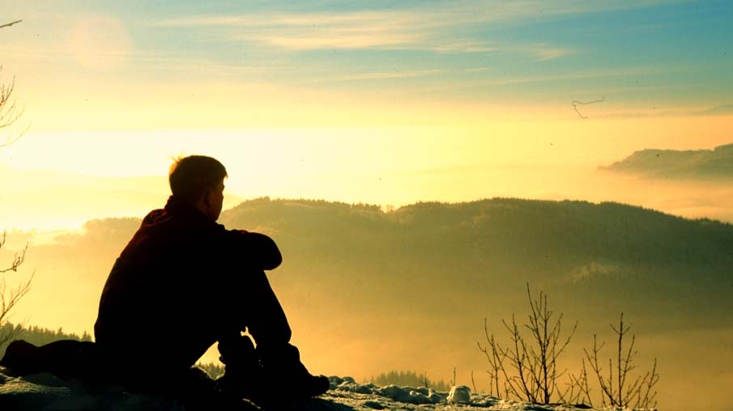
A voice of one calling in the wilderness

Slide 3
Repentance

Slide 4
“A voice of one calling in the wilderness, ‘Prepare the way for the Lord, make straight paths for him. Every valley shall be filled in, every mountain and hill made low. The crooked roads shall become straight, the rough ways smooth. And all people will see God’s salvation.’” (Luke 3:4-6, Isaiah 40:3-5)

